Slide 1


BALLARI INSTITUTE OF TECHNOLOGY & MANAGEMENT
Autonomous Institute under VTU, Ballari-Hospet Road, Allipur, Ballari-583 104 Karnataka ,India
Department of Artificial Intelligence & Machine Learning
A Phase-2 Project on
CLEARVIEW: AN IMAGE RESTORATION AND ENHANCEMENT
Presented by
SYED ABU ABDULLA 3BR22AI164
U SRI LAKSHMI 3BR22AI174
UDAY KUMAR G 3BR22AI175
VAIBHAV K 3BR22AI179
Project Guide
Dr. Hemavati C Purad
Associate Prof, Dept. of AIML
Project Coordinator
Mrs. P Asha jyothi
Asst.Prof, Dept. of AIML
Dr. B.M Vidyavathi
Head of the Department
Dept. of AIML

Slide 2
Abstract
The An Image Restoration Technique presents an Intelligent Image Restoration and Enhancement System using Deep Learning Techniques. It detects such as brightness, contrast, and low-light and applies suitable models including ZERO-DCE and Pix2PixHD ensures uniform input through resizing and normalization, while advanced libraries handle image processing efficiently the system produces clear, high-quality images with minimal user effort.

Slide 3
Contents
Introduction
Objectives
Problem Statement
Scope of the Project
Literature Survey
Domain
Proposed System
7.1 Architectural Diagram
7.2 Modules And Functionality
Methodology
8.1 Techniques
8.2 Development Model
8.3 Tools And Technologies
Requirements Specification
9.1 Functional Requirements

Slide 4
9.2 Non-Functional Requirements
9.3 Hardware Requirements
9.4 Software Requirements
Design
10.1 Use Case Diagram
10.2 Context Diagram
10.3 Class Diagram
10.4 Activity Diagram
Implementation
Results and Discussion
Snapshots
Testing cases
Expected Outcomes
Applications
17. Timeline
18. Conclusion
References

Slide 5
1. Introduction
Good image quality is important in photography, surveillance, media.
Images taken in natural often suffer from noise, blur low resolution, or bad lighting, which lowers their quality and usefulness.
Image restoration means using methods to fix bad images by removing brightness, darkness, reducing blur, and making them clearer.
Traditional methods use fixed filters that may not handle real-world image problems well, while modern deep learning methods offer better results.

Slide 6
2. Objectives
To develop a system to restore degraded or low-quality images.
To enhance images affected by noise, blur, dark.
To improve visual clarity and detail across diverse image domains.
To provide a simple interface for users to upload, process, and view results.

Slide 7
3. Problem Statement
This project aims to develop an intelligent system that combines image restoration and enhancement, automatically adapting to the image’s condition to produce high-quality and visually appealing results across diverse degradation types.

Slide 8
4. Scope of the Project
Image Enhancement
Image Restoration

Slide 9
5.Literature Survey
Models/Paper/Technique | Author & Title | Year | Summary | Dataset | Gaps Identified
ZERO-DCE | Chunle Guo:Learning to Enhance Low-Light Image via Zero-Reference Deep Curve Estimation | 2020 | module used: Zero-DCE Parameters: ~10k(zero dc++) Accuracy : ~80-90%z | LOL Dataset | Noise gets amplified in extremely dark images; weak performance in overexposed/bright regions; sometimes causes unnatural color tones.
Pix2pixHD | Wang et al., “High-Resolution Image Synthesis and Semantic Manipulation with Conditional GANs (Pix2PixHD)” | 2018 | Pix2PixHD is a high-resolution GAN model that converts semantic maps or sketches into realistic images. It uses multi-scale generators and discriminators to produce detailed, photorealistic results. | Custom Exposure Correction Dataset, High- Exposure Image Sets | It requires large datasets and powerful GPUs, making it unsuitable for real-time or mobile use. Pix2PixHD also cannot perform low-light or exposure correction tasks.
Classical Image Processing Filters (CLAHE, Histogram Equalization, Smoothing, Sharpening) | Rafael C. Gonzalez & Richard E. Woods, 4th Edition | 2018 | This book introduces fundamental image processing techniques such as CLAHE, histogram equalization, contrast stretching, smoothing, sharpening, and noise filtering. These classical filters improve brightness, contrast, and clarity using mathematical transformations. | Not dataset-based (the book explains general techniques). | Ineffective for extreme low-light or overexposure; cannot adapt automatically, no learning capability, limited performance compared to deep-learning models.

Slide 10
6.Domain
Core Domain (Technical Focus):
Image Processing
Deep Learning & Neural Networks
Computer Vision
Application Domain (Real-world Area):
Digital Media Restoration and Enhancement
Photography
Surveillance & Security Enhancing
Historical Archiving Restoring

Slide 11
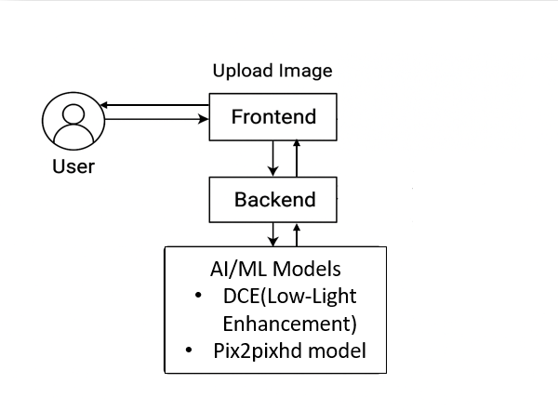

7.Proposed System
7.1 Architectural Diagram
Fig1 : Architectural Diagram

Slide 12
7.2Models/Filters and their Functionality
Task | Models and Filters | Functionality
Low-Light Enhancement | Zero-DCE | Enhances low-light images without needing paired training data using a deep curve estimation approach.
Overexposure/Flash Correction | Pix2pixHD | This module corrects overexposed, flashed, or overly bright images using the Pix2PixHD GAN model.
Improve local contrast | Adaptive CLAHE | Enhances local contrast in dark/flat regions while preventing over-amplification.
Increase global contrast smoothly | Gentle Contrast Enhancement | Uses Gaussian blur + weighted addition to increase contrast and bring out details naturally.
Fix unnatural color tint . | Color Balance (conditional) | Balances RGB channels so the image looks natural; applied only if brightness > 100
Reduce noise | FastNlMeans DenoisingColored | Removes color noise and grain without losing details; final cleanup before saving.

Slide 13
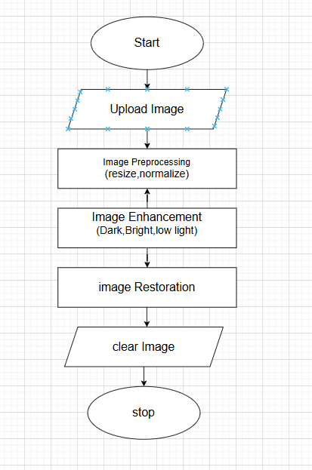
8.Methodology

Slide 14
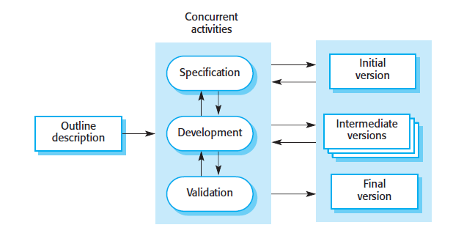
8.2 Development Model
Fig 3: Incremental Software Development Model

Slide 15
8.3 Tools and Technologies Used
Technologies
Deep Learning – For learning complex patterns in degraded images.
Programming Languages and Frameworks
Python – Primary language for model development and implementation
PyTorch / TensorFlow – Deep learning frameworks for training and using models.
OpenCV – For image processing operations.
Computer Vision – For degradation detection and feature extraction.
Image Processing – Techniques for resizing, normalization, brightness, contrast adjustment.
NumPy & Matplotlib – For numerical computation and result visualization.

Slide 16
9. Requirements
9.1 Functional Requirement
Image Upload
Image Preprocessing
Image Enhancement
Image Restoration

Slide 17
9.2 Non-Functional Requirements
Usability
Performance
Scalability
Modularity
Reliability
Portability

Slide 18
9.3 Hardware Requirements:
Processor: Minimum Intel Core i5 or equivalent.
RAM: 8 GB or higher.
Storage: 500 GB HDD or SSD (preferably SSD for better performance).

Slide 19
9.4 Software Requirements:
Operating System: Windows 10/11
Programming Language: Python 3.8+, NumPy, Pandas, OpenCV, TensorFlow, Py Torch

Slide 20
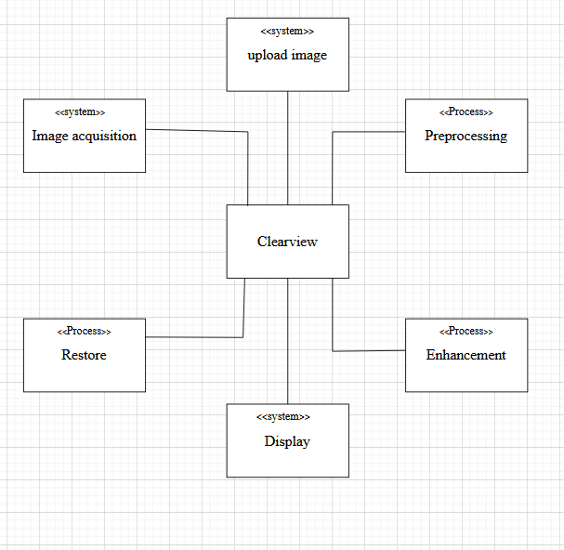
10.Design
Fig 10.1 : Context diagram

Slide 21
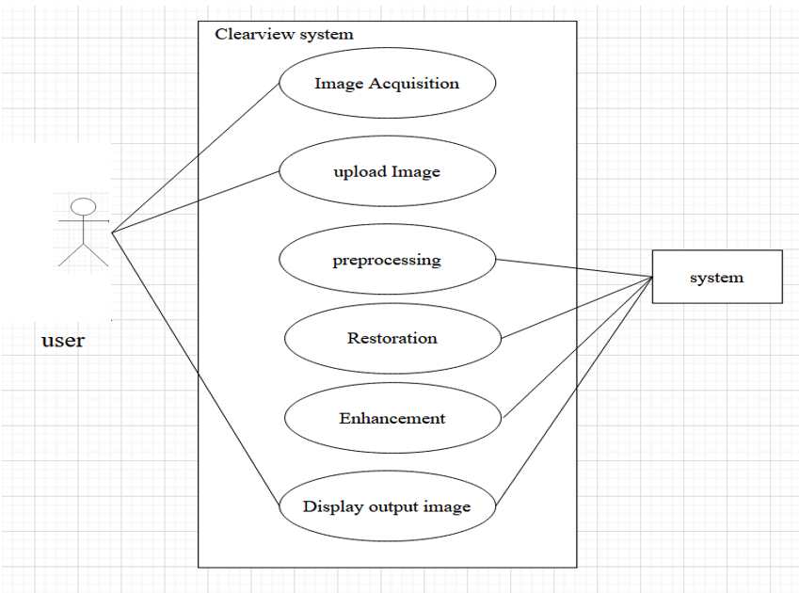
Design
Fig 10.2 : Use Case diagram

Slide 22
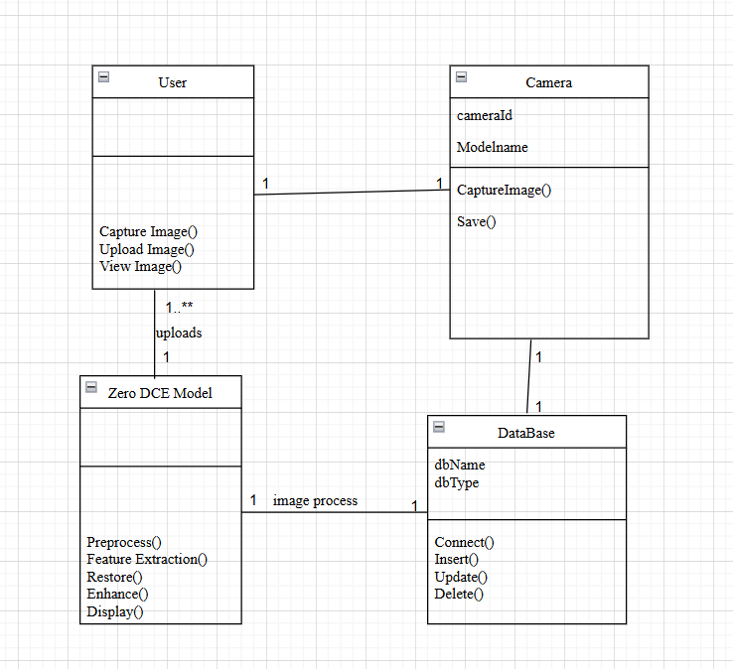
Design
Fig 10.3 : Class diagram

Slide 23
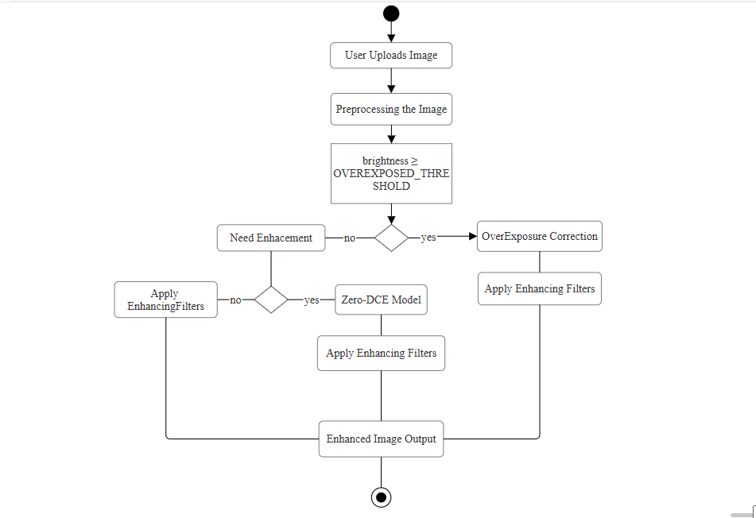
Design
Fig 10.4 : Activity diagram

Slide 24
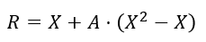
11. Implementation
1. Zero-DCE Model uses curve estimation and iterative enhancement.
Image Enhancement Curve Formula
Where:
X = input pixel
A = enhancement map (A-map) predicted by Zero-DCE
R = enhanced output pixel
This is the heart of Zero-DCE.

Slide 25
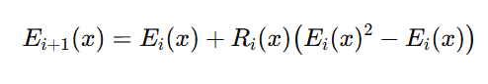
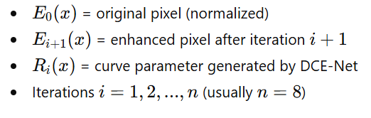
Continued..
Iterative Enhancement Formula
Zero-DCE applies curve many times (usually 8 iterations):

Slide 26
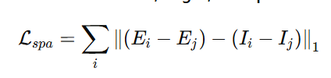
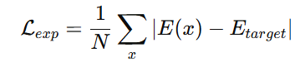
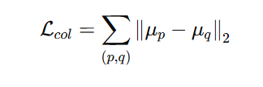
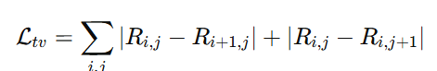
Continued..
Zero-DCE is trained using a combination of four loss functions:
Spatial Consistency Loss
Exposure Control Loss
Color Constancy Loss
Illumination Smoothness Loss

Slide 27
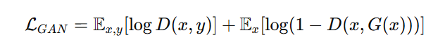
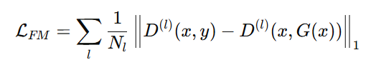
Continued..
2. Pix2PixHD (Overexposure Correction Model)
The Pix2PixHD generator is a Global Generator Network that produces high-resolution corrected images.
It follows a standard encoder ->ResNet -> decoder structure.
It learns using four main loss functions
Adversarial Loss:
Feature Matching Loss

Slide 28
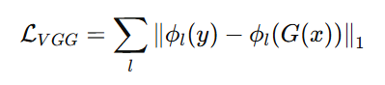
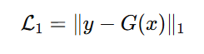
Continued..
3. Perceptual Loss
4. Pixel Reconstruction Loss

Slide 29
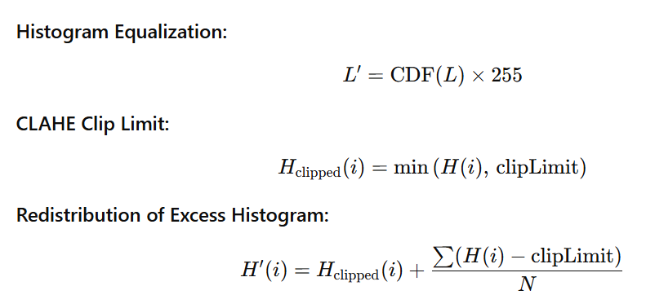
Continued..
Filters:
Adaptive CLAHE:

Slide 30
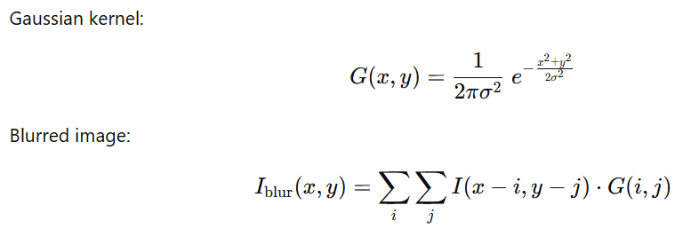
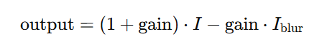
Continued..
2. Gaussian Blur Filter:
3. Weighted Image Sharpening:

Slide 31
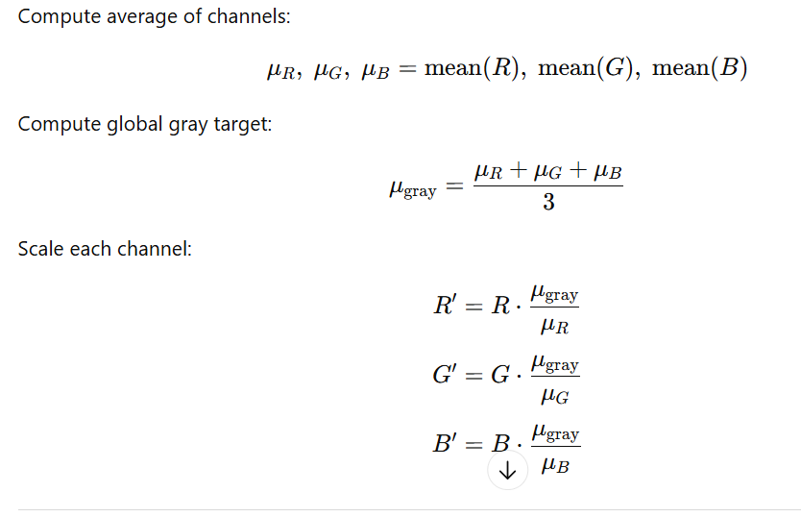
Continued..
4. Color Balance:

Slide 32
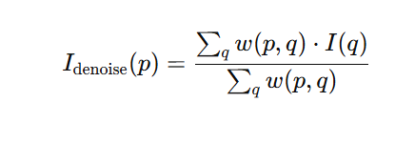
Continued..
5. Non-Local Means Denoising:

Slide 33
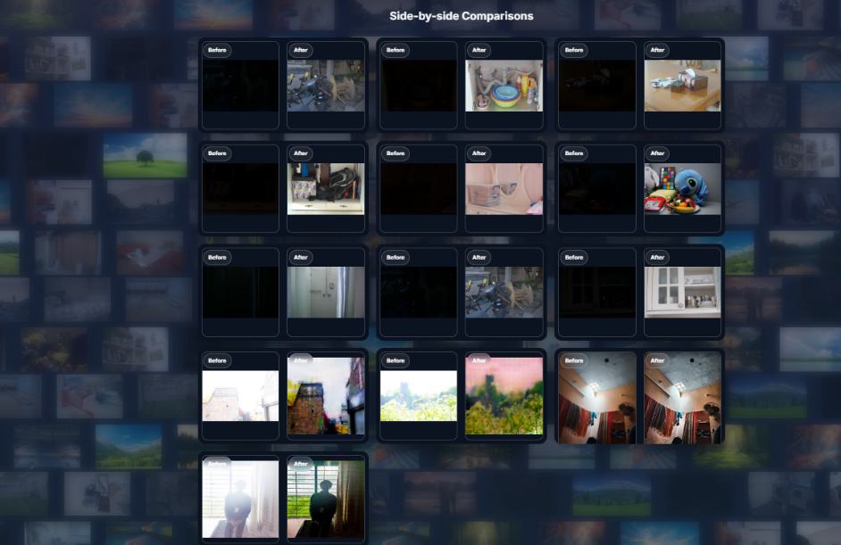
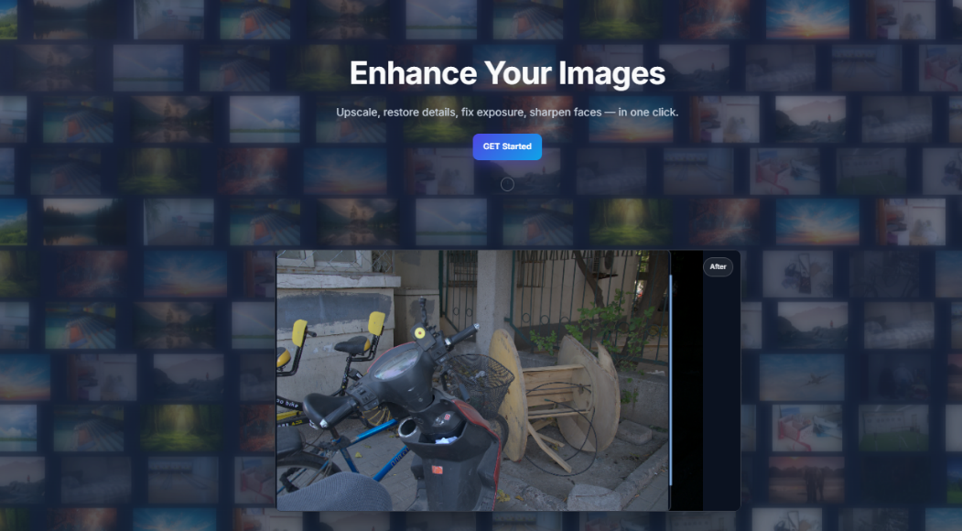
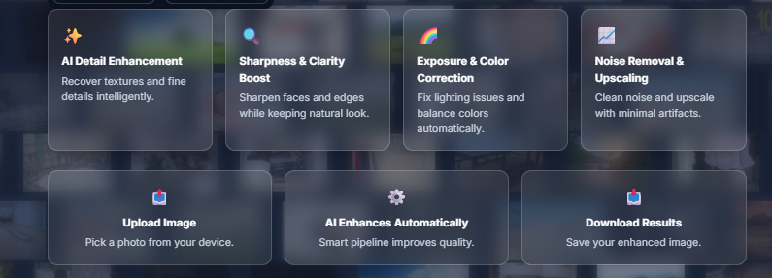
12.Snapshot
Fig12.1 Welcome Page
Fig12.2 Samples
fig 7: Enhanced Image from dark image
Fig12.3 Contents

Slide 34
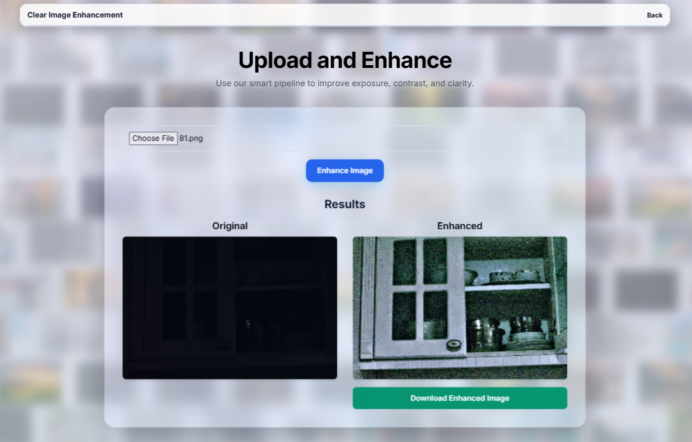
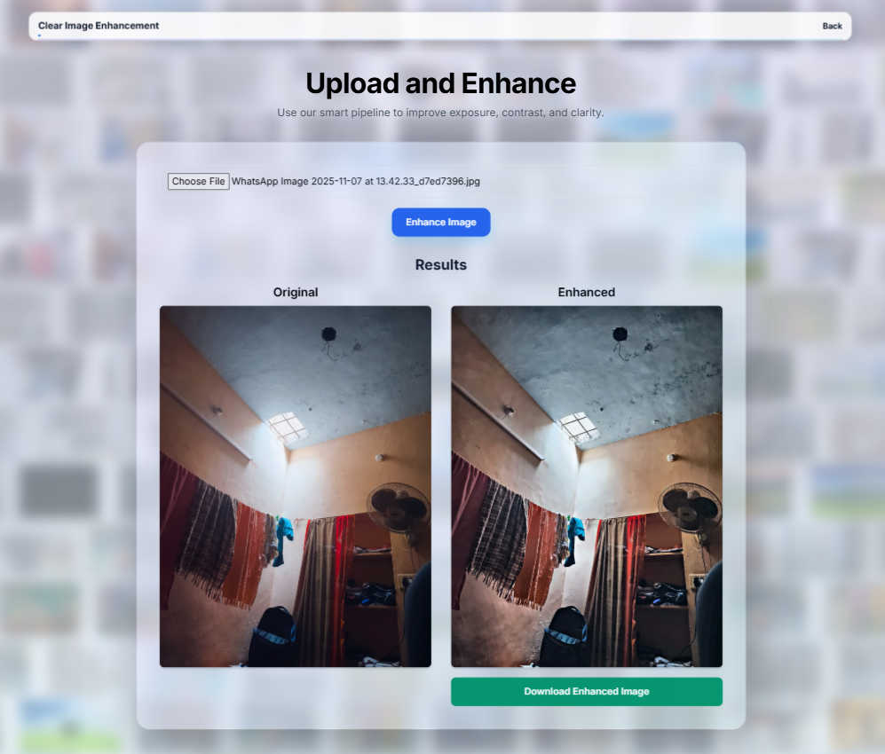






Fig 12.4 Enhancement of dark image
Fig 12.5 Enhancement of Normal image

Slide 35
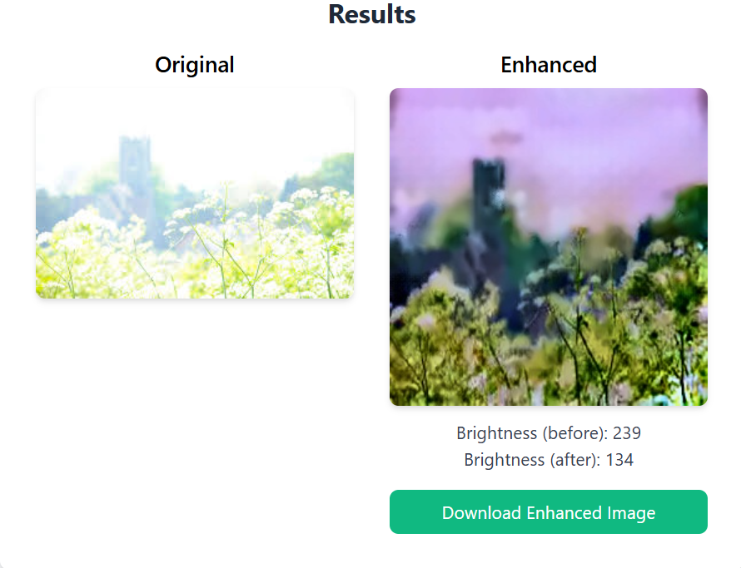
Fig12.6: Enhancement of overflashed image

Slide 36
Testing Phase
Test case ID | Input | Description | Expected result | Pass/Fail
TC_01 | Dark / low-light image | Test Zero-DCE enhancement pipeline (A-map generation + iterative curve + post-processing) | Output image should be brighter, noise-reduced, improved contrast and color | Pass
TC_02 | Overexposed / flashed image | Test Overexposure Correction Module (Pix2PixHD + CLAHE + color balance) | Output image should have reduced flash, restored details, natural colors | Pass
TC_03 | Normal Image | Test Normal-to-Normal enhancement (CLAHE + contrast + denoising) | Output image should show mild clarity improvement without over-enhancement | Pass

Slide 37
12.Expected Outcome
Restoration of degraded images.
Intuitive interface for easy usage.
Scalability.
Stable system performance.
Improved Visual Appeal.

Slide 38
13.Future Scope
Enable real-time image/video uploading and processing
Develop mobile applications for wider accessibility
Integrate advanced AI models for higher accuracy

Slide 39
14.Timeline
Phase | Description | Duration
1 | Synopsis + Literature Survey + Problem Statement | 12/03/25 – 05/05/25
2 | Design | 25/03/25– 10/06/25
3 | Module Development | 10/11/25
4 | Integration + Testing + Final Report | 21/11/25

Slide 40
15.Conclusion
This project delivers an adaptive image restoration system leveraging deep learning. It improves image quality across a variety of domains while maintaining user accessibility and scalability.

Slide 41
References
[1] C. Guo, C. Li, J. Guo, C. Loy, J. Hou, S. Kwong, and R. Cong, “Learning to enhance low-light image via Zero-Reference Deep Curve Estimation,” in Proc. IEEE/CVF Conf. Compute. Vis. Pattern Recognition. (CVPR), 2020, pp. 1777–1786.
[2] S. W. Zamir, A. Arora, S. Khan, M. Hayat, F. S. Khan, M. Yang, and L. Shao, “Multi-stage progressive image restoration,” in Proc. IEEE/CVF Conf. Comput. Vis. Pattern Recognition. (CVPR), 2021, pp. 14821–14831.
[3] X. Wang, L. Xie, C. Dong, and Y. Shan, “Real-ESRGAN: Training real-world blind super-resolution with pure synthetic data,” in Proc. IEEE/CVF Int. Conf. Comput. Vis. Workshops (ICCVW), 2021, pp. 1905–1914.
[4] I. Sommerville, Software Engineering, 9th ed. Boston, MA, USA: Pearson Education, 2011, ISBN: 978-0-13-703515-3.

Slide 42


